Slide 1
Spring
Spring Data JPA and Hibernate

Slide 2
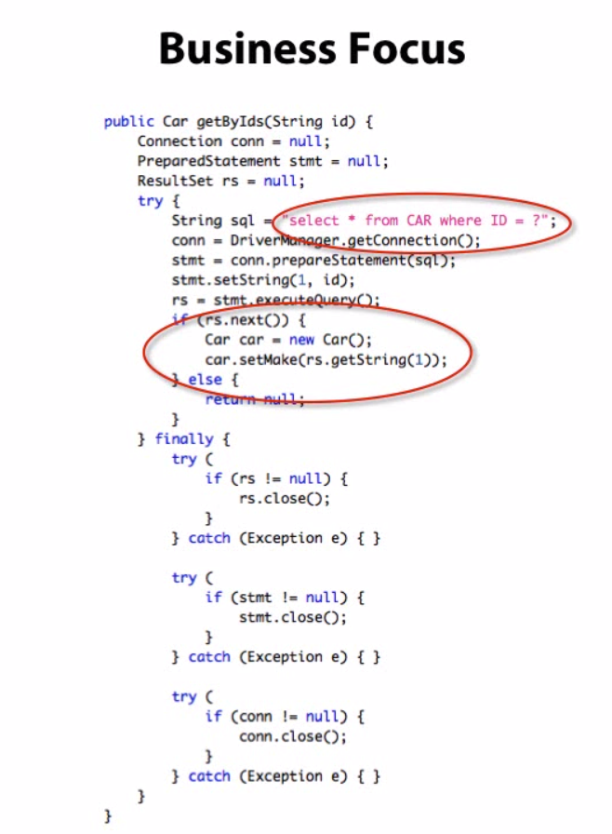


Evolution
JDBC
Hibernate
object-relational mapping (ORM) to be implemented by hand
ORM is done automatically, but DAO remains to be implemented by hand
must be implemented manually
Towards more Business Logic
Hibernate
+
Spring Data JPA
ORM does it automatically: DAO is implemented automatically
DAO

Slide 3
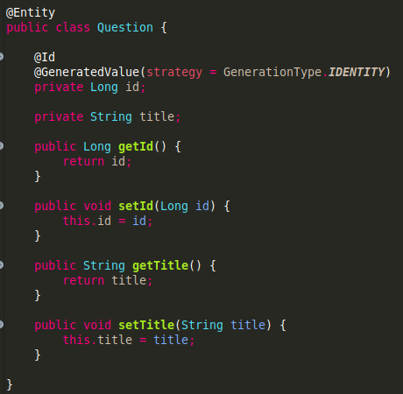





JPA
JPA (Java Persistence API)
Set of Standards
Entities
Repository (DAO)
Purpose: correspondence between the Java object and the SQL table
Purpose: methods for CRUD operations
save()
findById()
findAll()
delete()
...
Standards & Specifications
Hibernate
Spring Data JPA

Slide 4
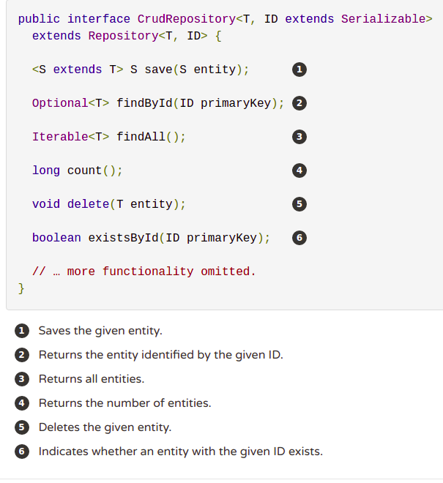
Spring Data JPA
Interfaces
CrudRepository
PagingAndSortingRepository
One repository to rule them all
JpaRepository

Slide 5

Spring Data JPA
Project Architecture
JpaRepository
(Repository)
Wilder
(Entity)
WilderRepository
Create an “API” in 15 minutes
WilderController

Slide 6
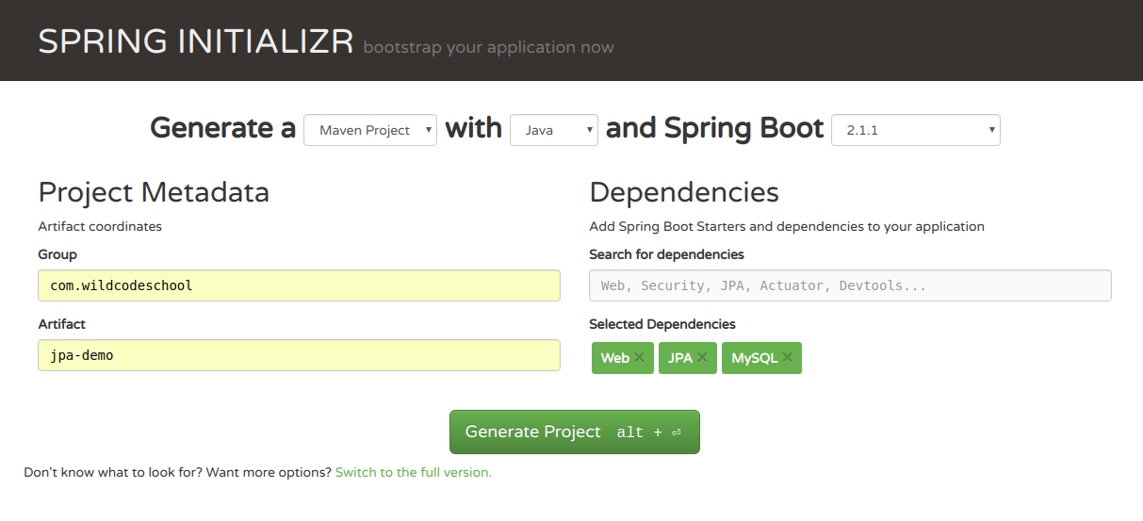
Spring Data JPA
1.1 Initialisation: Generate Maven POM with Spring Initializr
Create an “API” in 15 minutes

Slide 7

Spring Data JPA
1.2 Initialisation: Create Database and User
Create an “API” in 15 minutes

Slide 8
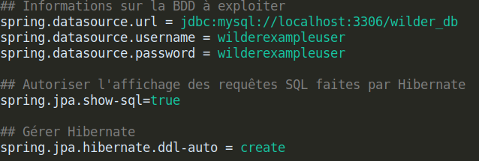
Spring Data JPA
1.3 Initialisation: Configure application.properties
Create an “API” in 15 minutes
create
create-drop
update
none

Slide 9
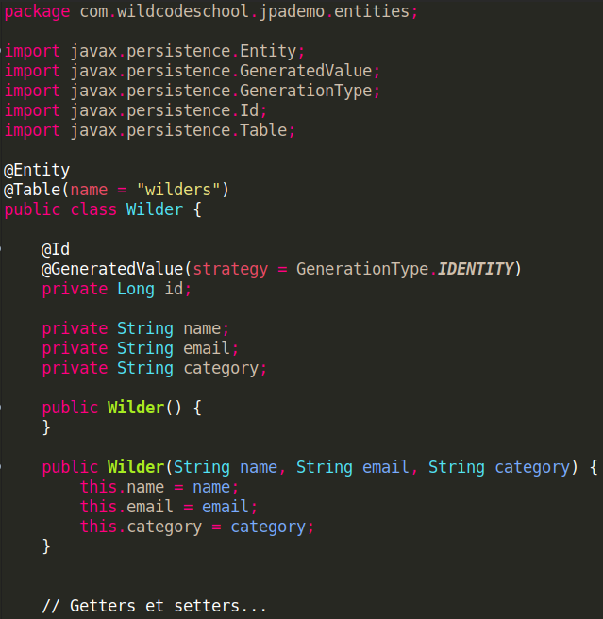
Spring Data JPA
2. Create Wilder Entity
Optional
Delegate generation of id to MySQL
Create an “API” in 15 minutes
The attributes will be automatically converted to MySQL table columns

Slide 10
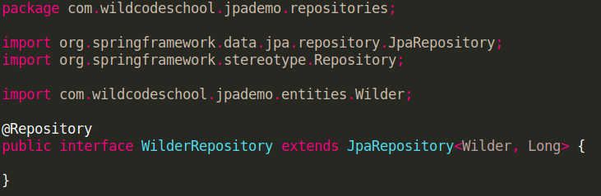
Spring Data JPA
3. Create Repository
Create an “API” in 15 minutes
Which entity is managed by this repository?
What is the type of id (the primary key)?

Slide 11
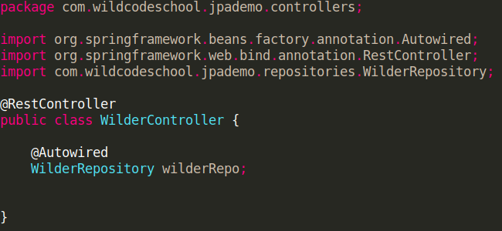
Spring Data JPA
4. Create (REST-)Controller
Create an “API” in 15 minutes
We inject the repository we just created

Slide 12
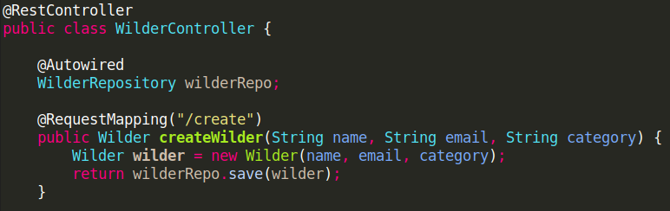
Spring Data JPA
4.1 Create RequestMapping on Controller for create
Create an “API” in 15 minutes
Responds to a request like http://localhost:8080/create?name=micheline&email=micheline@wcs.fr&category=wildeuse
Note: To explicitly state the parameter binding, use
@RequestParam(“name”) String name
for all method parameters

Slide 13
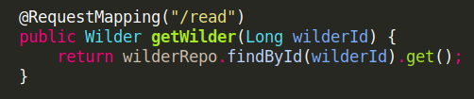
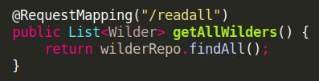
Spring Data JPA
4.2 Create RequestMapping on Controller for read
Create an “API” in 15 minutes
Responds to a request like http://localhost:8080/read?wilderId=1
Responds to a request like http://localhost:8080/readall
Note: To explicitly state the parameter binding, use
@RequestParam(“wilderId”) Long wilderId
for all method parameters

Slide 14
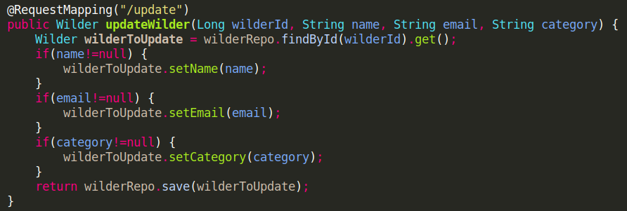
Spring Data JPA
4.3 Create RequestMapping on Controller for update
Create an “API” in 15 minutes
Responds to a request like http://localhost:8080/update?wilderId=1&email=micheline.blop@wcs
Note: To explicitly state the parameter binding, use
@RequestParam(“wilderId”) Long wilderId
for all method parameters

Slide 15
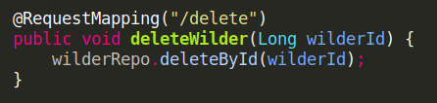
Spring Data JPA
4.4 Create RequestMapping on Controller for delete
Create an “API” in 15 minutes
Responds to a request like
http://localhost:8080/delete?wilderId=1
Note: To explicitly state the parameter binding, use
@RequestParam(“wilderId”) Long wilderId
for all method parameters

Slide 16
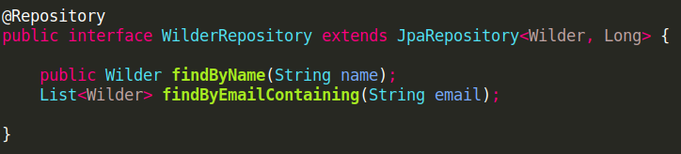
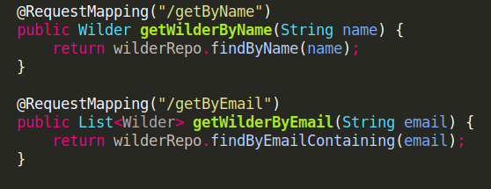
Spring Data JPA
5. Bonus: Create custom methods
Create an “API” in 15 minutes
https://docs.spring.io/spring-data/data-jpa/docs/current/reference/html/#jpa.query-methods.query-creation

Slide 17

Spring Data JPA
5.1 Testing in the browser
Create an “API” in 15 minutes
5.2 Verify in MySQL Workbench

Slide 18


One-to-many, many-to-one
Question.java (entity)
Answer.java (entity)
Bidirectional Relations

